Slide 1
Data Service Server
Zach Chih, RD, Embedded-IoT
May 14, 2019

Slide 2

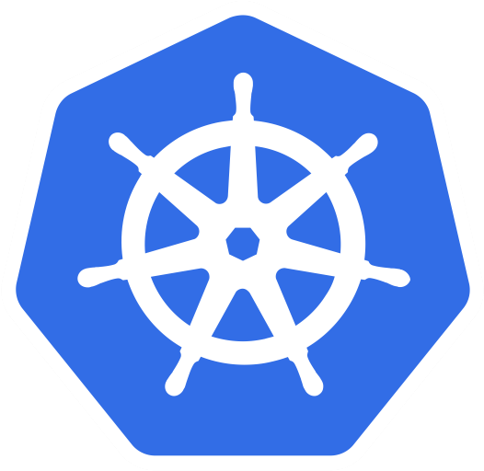
What Is Kubernetes (aka k8s)?
https://technologyadvice.com/blog/information-technology/kubernetes-vs-docker

Slide 3
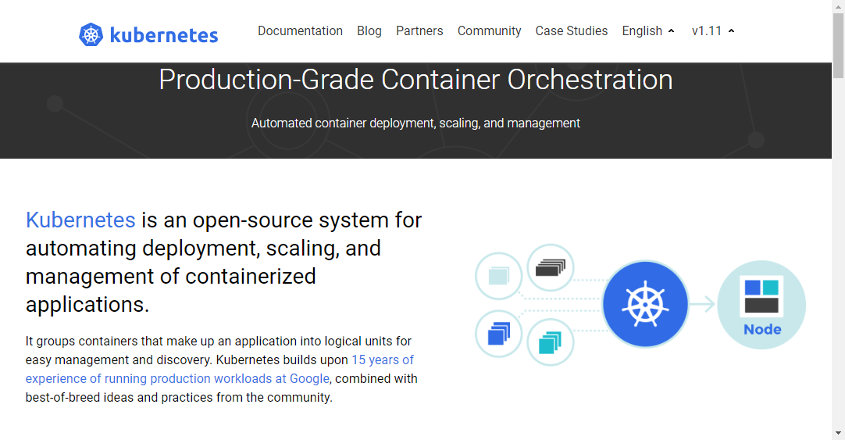
Kubernetes is
Production-Grade container orchestration.
An open-source system for automating deployment, scaling, and management of containerized applications.
https://kubernetes.io

Slide 4
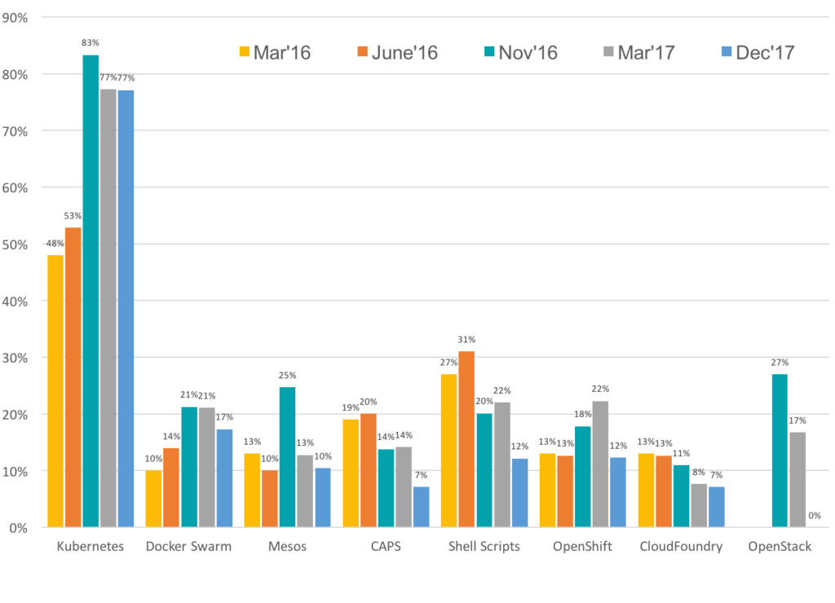
The Evolving Landscape of Container Management Platforms

Slide 5
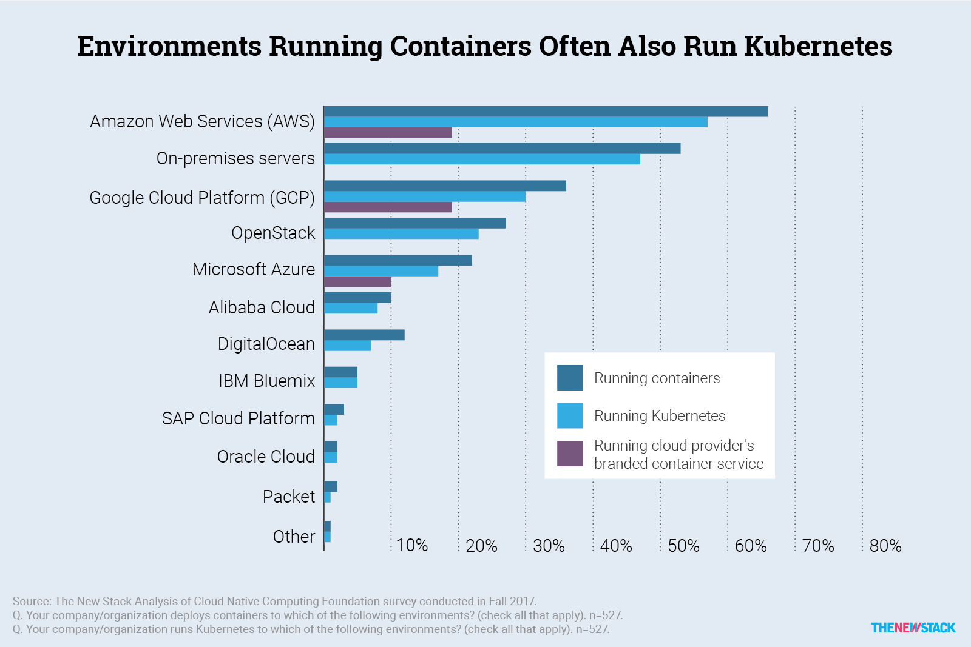

Slide 6
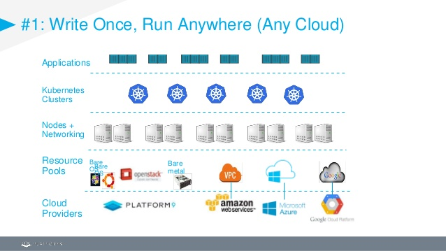

Slide 7

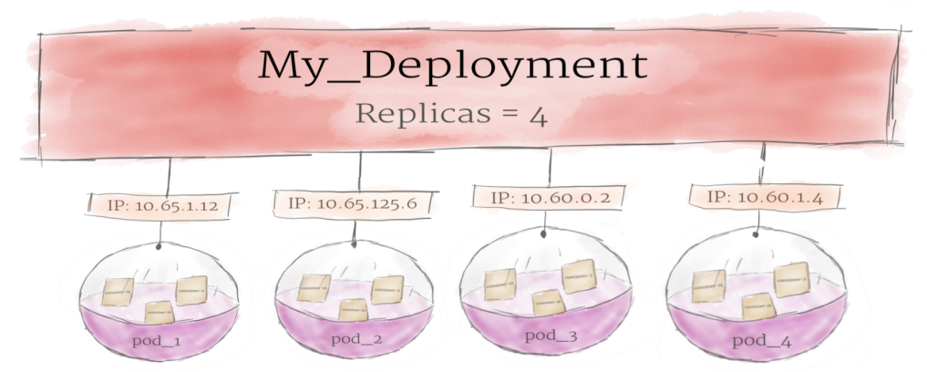

Essential Concepts In Kubernetes
container
Deployment
Pod
https://medium.com/google-cloud/kubernetes-101-pods-nodes-containers-and-clusters-c1509e409e16

Slide 8
Pod
01 02 03 04 05 06 07 08 | kind: Pod apiVersion: v1 metadata: name: nginx spec: containers: - name: nginx image: nginx
$ kubectl create -f 03_pod/pod.yaml
$ kubectl get pods -o wide --show-labels

Slide 9
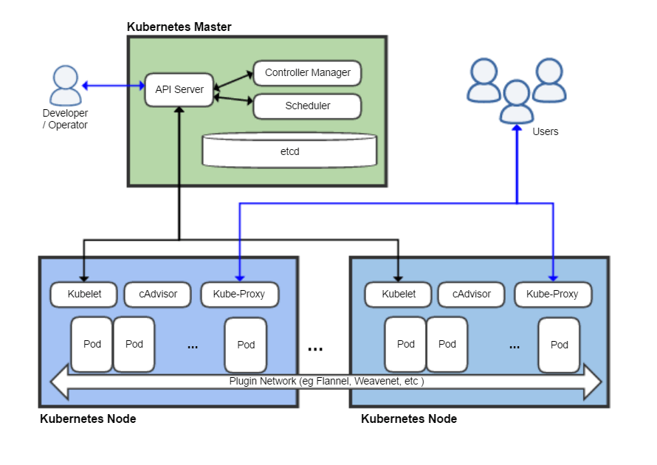
The Kubernetes architecture and scalability

Slide 10
Useful Tools
minikube
A tool that makes it easy to run Kubernetes locally.
kubeadm
It performs the actions necessary to get a minimum viable cluster up and running. By design, it cares only about bootstrapping, not about provisioning machines.
kops
Helps you create, destroy, upgrade and maintain production-grade, highly available, Kubernetes clusters from the command line.
AWS (Amazon Web Services) is currently officially supported, with GCE in beta support , and VMware vSphere in alpha, and other platforms planned.
kubectl
A command line interface for running commands against Kubernetes clusters.
create, delete, exec, get, logs, replace

Slide 11
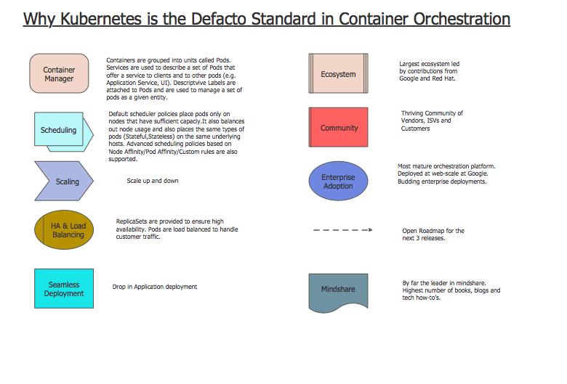

Slide 12

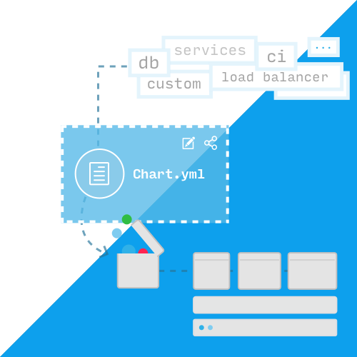
Helm
Helm
Making container-based applications easier to deploy on Kubernetes.
creating a package manager for Kubernetes applications.
make installing new applications on Kubernetes as easy as running helm install <chart-name>.

Slide 13





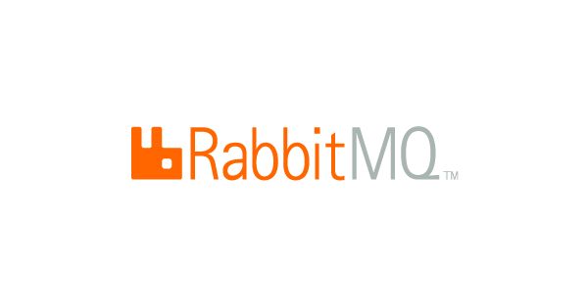








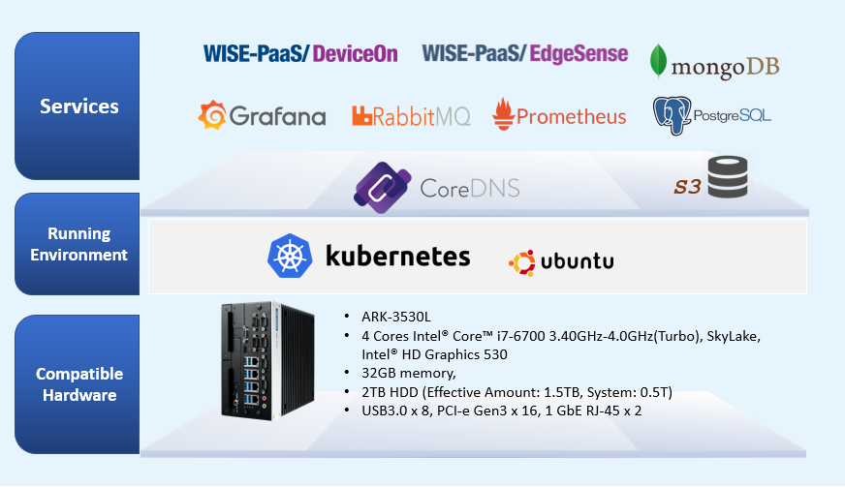
Data Service Server Architecture
Device management
Auto deployment
Data
Service
Package
Backend Server Management
IoT Hub
Database Management
Self-Healing
Automated Rollback
Auto Scaling
Load Balancing

Slide 14
Data Service Package Component
Components | Services | Memory Used | Storage Allocated
Container Runtime | Moby | 1G
Persistent Storage | Ceph | 2G
Container Orchestration | Kubernetes | 1G
Database | MongoDB | 6G | 1152G
 | PostgreSQL | 0.512G | 8G
IoTHub | RabbitMQ | 6G | 64G
S3 Compatible Storage | Minio | 0.256G | 128G
System Monitoring | Prometheus | 2G | 256G
Visualization Dashboard | Grafana | 0.128G | 10G
Load Balancing | Nginx-Ingress | 0.512G
DNS | CoreDNS | 0.512G
Private Chart Repo | Chartmuseum | 0.128G | 8G
Device Management | WISE-PaaS/EdgeSense | 3.512G
Infrastructure
Ubuntu 16.04 Desktop (License Required)
Kubernetes 1.11.3
Memory Usage
25G/32G
Storage Usage
2T/10T

Slide 15
Single Node HW Capacity
400 Edge Devices
30000 Tags/Sec
1TB Storage Used Per Week
System Monitor (Grafana with Prometheus)
Monthly Recycle
5s, Sample Rate
150G Storage Used

Slide 16


Service Deployment and Purchase from marketplace
200 Points / master node
* 1 Point = 10 USD
Data Server Package
Perpetual License
Include 10 EdgeSense/DeviceOn license and 3 months S/W service fee
*SW service included SW consulting and package upgrade

Slide 17
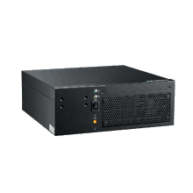

Product SKU Offering and pricing
SKU/Config. | Server Quantity | Compute (CPU) | Memory (GB) | Physical Storage (TB) | SRP Pricing | Pricing
Entry | *Master/Node x1 | 4 | 32 | 2 | 200 WP (Include 10 DeviceOn license) | $2000
Advanced | *Master/Node x3 (w/ HA) | 12 | 96 | 6 | 500 WP (Include DeviceOn license) | $5000
Addition | Node x1 | 4 | 32 | 2 | 100 WP (DeviceOn recharge excluded) | $1000
Master
Master
Master
Master
Node
*Converged (Master) node running Kubernetes master and worker node on the same machine.

Slide 18
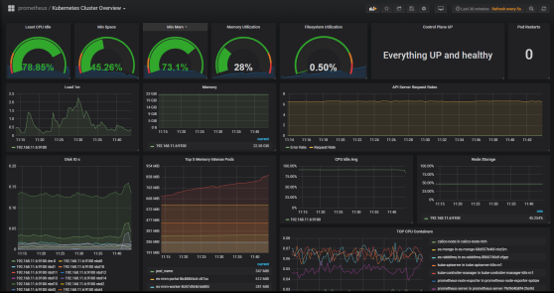
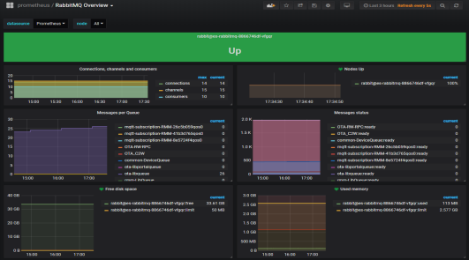
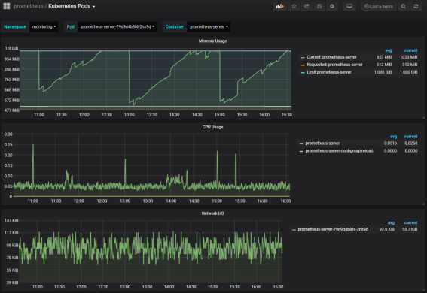
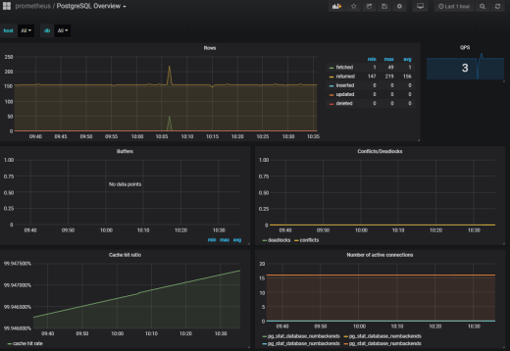
IoT Data Server platform management
Data Server Monitor
Cluster Resources Usage
Service Statuses
IoT Hub Monitor
RabbitMQ Health Status
Resource Usages
Pod Monitor
Pod container information and monitor
Container APP monitor
Database Monitor
Postgres/Mongo
Resource Usages

Slide 19
Go Together,
We Go Far and Grow Big

